Slide 1
Covalent bonding
Unit 1

Slide 2
Vocab List
Covalent
Metallic
Electrons
Valence
Ionic
Ionic Compounds
Lewis Diagram
Monoatomic
Polyatomic
Metals
Non-metals
Cations
Anions
Electronegativity
Crystalline lattice

Slide 3
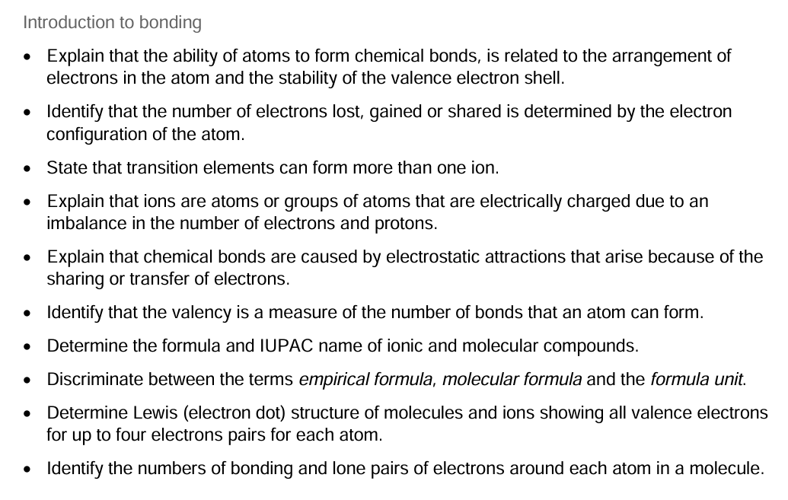
Learning Goal

Slide 4
Types of bonds
Type of Bond | Occurs between | Description
Covalent | Non-metals | electrons shared between atoms.
Ionic | Metals ionically bonded to non-metals | atoms that have lost / gained electrons experience electrostatic attraction to each other.
Metallic | Metals | electrons shared amongst a lattice of metal cations.

Slide 5
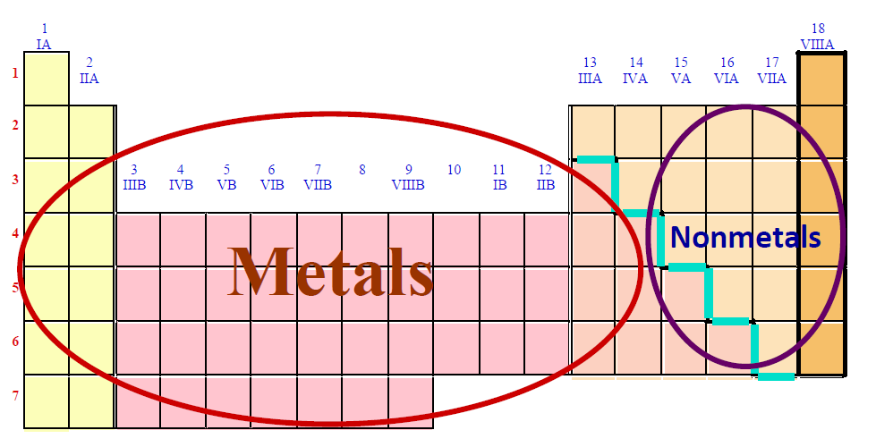
Remember…

Slide 6
Why do covalent bonds form?
Think back to the atomic structure and electron configuration.

Slide 7
Naming conventions – binary covalent compounds
1) Name the non-metal furthest to the left of the table.
2) Name the other non-metal by its elemental name. Give it the suffix –ide.
3) Use prefixes to indicate the number of atoms in the molecule.
Prefixes
mono – 1 (not used for the first atom) di – 2 tri – 3 tetra – 4

Slide 8
Example – Name N₂O
1) Name the non-metal furthest to the left of the table.
2) Name the other non-metal by its elemental name. Give it the suffix –ide.
3) Use prefixes to indicate the number of atoms in the molecule.
nitrogen
nitrogen oxide
dinitrogen monoxide
Prefixes
mono – 1 (not used for the first atom) di – 2 tri – 3 tetra – 4

Slide 9
Your turn
1) Name the following compounds:
(a) CO₂ = Carbon Dioxide
(b) CCl₄ = Carbon Tetrachloride
2) Write the chemical formula for the following compounds:
(a) nitrogen tribromide = NBr₃
(b) carbon tetrafluoride = CF₄

Slide 10
Structure of covalent compounds
Lewis dot structures

Slide 11
Lewis dot structures
Determine the molecular formula and Lewis dot structure of:
CH₄ : 8e⁻
(a) carbon tetrafluoride = CF₄
1 * 4 + 4 * 7 = 32,
(b) phosphorus trifluoride = PF₃
(c) carbonate ion

